Slide 1
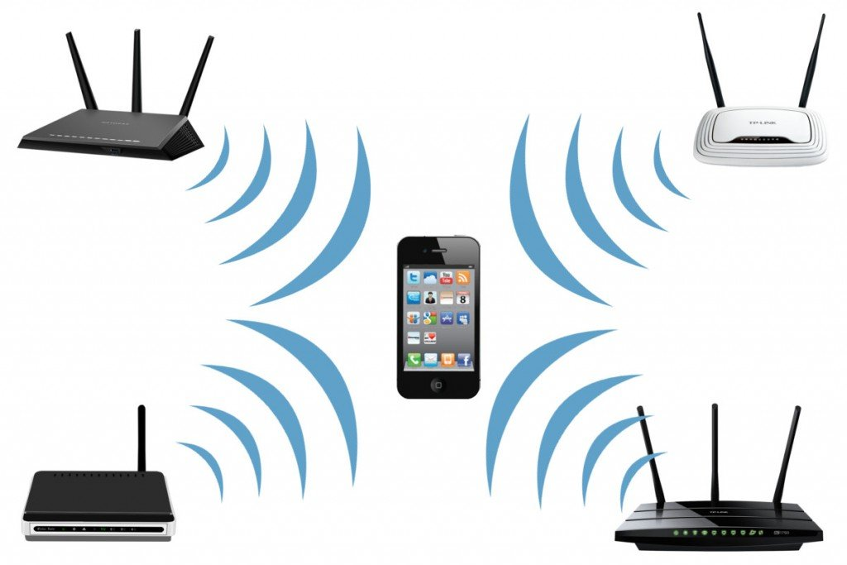
Slide 1
WiFi-Locationing
Thomas Schneider

Slide 2
Table of Content
Goals & Problem Definition
Initial Data Exploration
Data Preparation
Model comparison
Model improvement

Slide 3
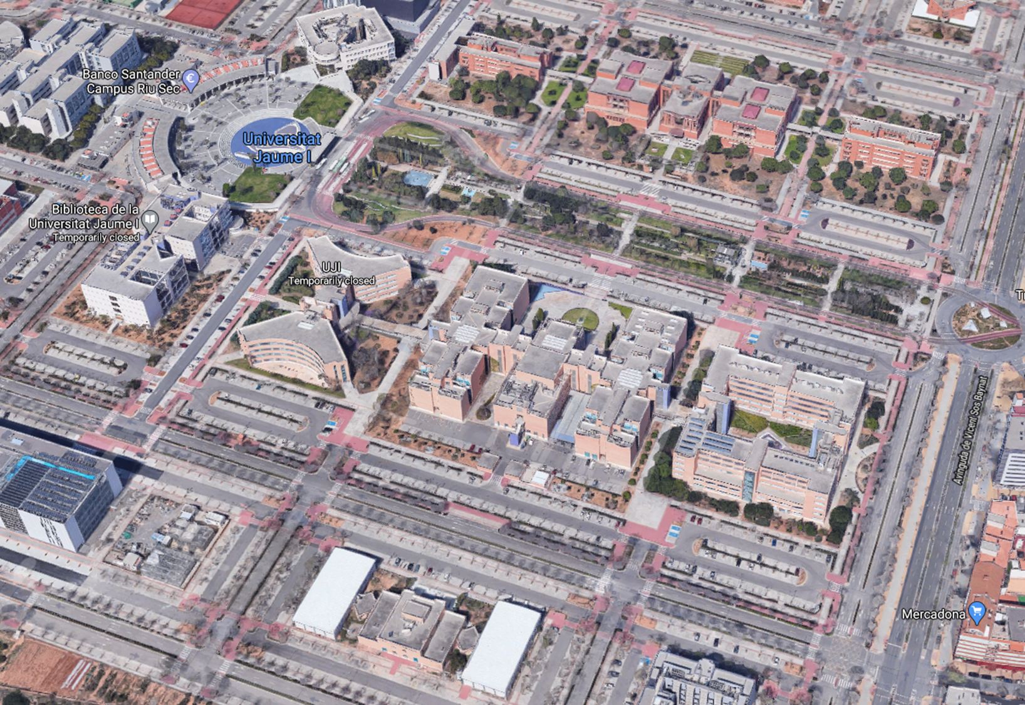
1. Goals & Problem Definition
GPS locating not reliable indoors → use Wi-Fi Data instead
Predict building, floor & location of Universitat Jaume I (110.000m²)
Compare various ML algorithms

Slide 4
2. Initial Data Exploration
20 different users & 25 distinct android devices
19,937 training & 1111 validation datapoints
529 attributes WiFi fingerprints (RSSI) measured as dBM

Slide 5
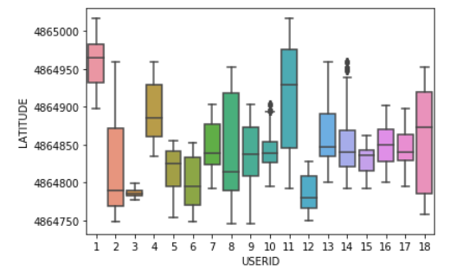
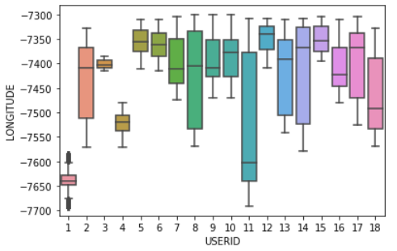
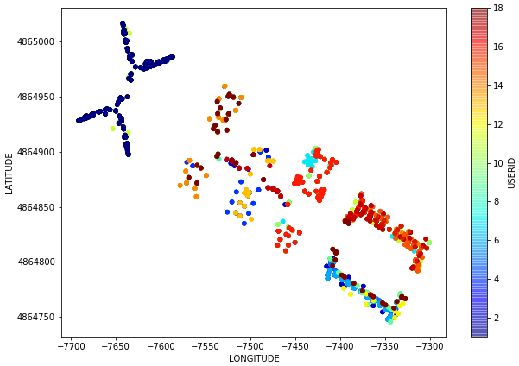

Slide 6
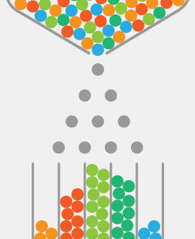
3. Data Preparation
Check for NAN →none
Replace 100 to -105 (100 wrong side of the scale)
Convert from dBM (log-scale) to mW (linear-scale)
Standardize by row (div. by sum of row → between 0 & 1)

Slide 7

4. Model Comparison
Longitude:
KNeighborsRegressor: -587,29 (later improved)
Ridge: -23820,76
SVM: -12183,27
DecisionTreeRegressor: -769,93
RandomForestRegressor: 399,166
Latitude:
KNeighborsRegressor: -115,22 (later improved)
Ridge: -3038,20
SVM: -2545,92
DecisionTreeRegressor: -476,60
RandomForestRegressor: -236,80
Floor:
LogisticRegression: 0,7817
LinearDiscriminantAnalysis: 0,7503
KNeighborsClassifier: 0,8243
DecisionTreeClassifier: 0,7552
GaussianNB: 0,5306
SVC: 0,3011
RandomForestClassifier: 0,8946
BuildingID:
LogisticRegression: 0,9925
LinearDiscriminantAnalysis: 0,9485
KNeighborsClassifier: 0,9950
DecisionTreeClassifier: 0,9711
GaussianNB: 0,9900
SVC: 0,5019
RandomForestClassifier: 0,9925

Slide 8

5. Model Improvement
Hyperparameter testing KNN-classifiers & regressors:
Longitude:
Best leaf size: 2; best p: 1; best n: 4 → RMSE: -46.64
Latitude:
Best leaf size: 1; best p: 1; best n: 3 → RMSE: -24.378
Floor:
Best leaf size: 1; best p: 2; best n: 1 → Accuracy: 0.9966
BuildingID:
Best leaf size: 1; best p: 2; best n: 1 → Accuracy: 0.9977

